Slide 1
ISO13606 Demographics Reference Model Revision
Rahil Qamar Siddiqui
(in capacity of) ISO13606 revision expert

Slide 2
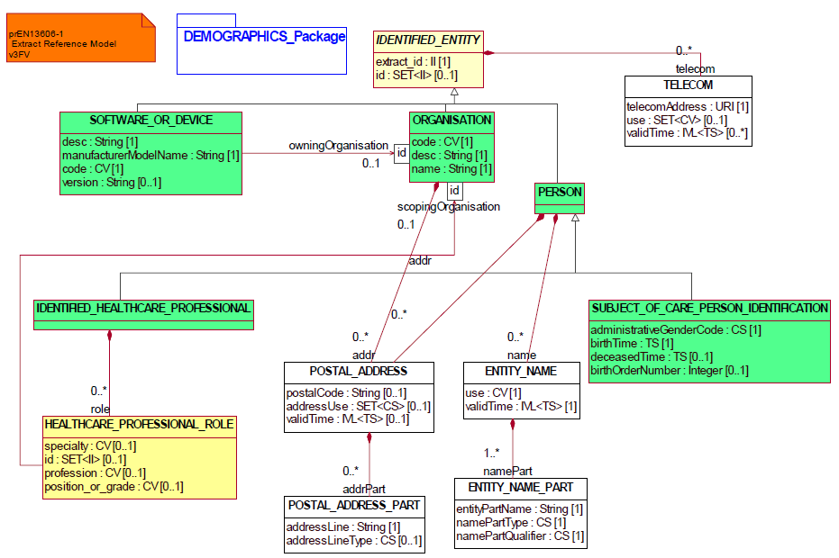
Existing Demographics Package

Slide 3
Approaches available to perform Demographic Modelling
Option 1: Using the ISO13606 Demographics Reference Model
Option 2: Using the ISO13606 Extract Reference Model for producing demographics models
Option 3: Create new DD4C Demographics Reference Model

Slide 4
Option 3: DD4C Demographics Reference Model

Slide 5
EN13606 Association Meeting
Productive meeting on Wednesday
Proposed DD4C Demographics Reference Model discussed
Changes made from other work done in enhancing the ISO13606 Demographics Model space
New proposed ISO13606 Demographics Model put to table for discussion

Slide 6
New proposed ISO13606 Reference Demographics Model

Slide 7
Benefits
The benefits of the proposed model are that
It provides the flexibility of creating demographics models that suit the needs of individual adopters without being restricted by the coverage of the current ISO13606 Demographics Reference Model.
By having generic building blocks, as in the ISO13606 Extract Reference Model, any kind and number of actor entities and their detailed parts/attributes can be created and used.
The proposed model is not constrained by the hierarchical structure of the ISO13606 Extract Reference Model and therefore, can be associated with any clinical logical model at the required and permitted data points.

Slide 8
Disadvantages
An established and published standard i.e. ISO13606 which includes a Demographics Reference Model will not be used. Any downstream implications of systems already making use of the ISO13606 Demographics Reference Model are currently unknown. However, there might be a possibility of mapping the logical demographics model to those based on the ISO13606 standard at some point, if required.
The demographics model cannot be viewed along with the clinical content in the same Editor view of LinkEHR. As with the ISO 13606 demographics model, the proposed demographics models will be referenced using the II attribute through the participation classes available from the Archetype view of the LinkEHR Editor.

Slide 9
Demo
XML Schema created based on new proposed demographics reference model
Can produce any number of reference demographics model to provide a library for adopters to start off with.

Slide 10
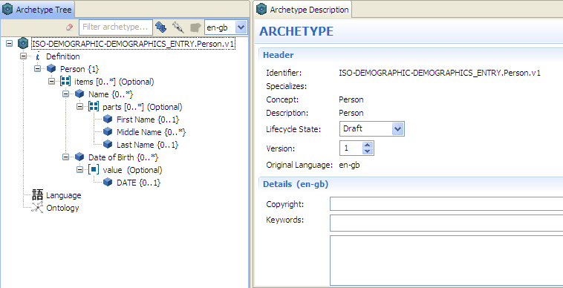
Person Demographics reference model

Slide 11
Thank you
Questions

